Slide 1
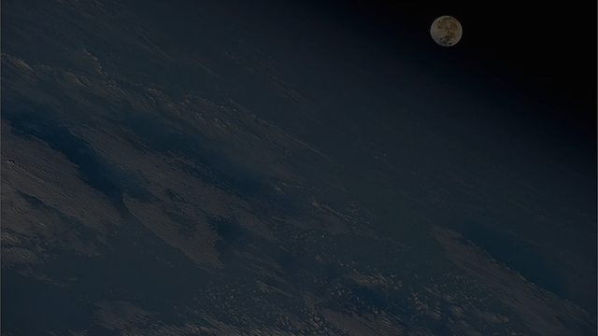


MBSE Avionics System Capstone
Sprint 2 Demo
Shawn
B.S. Electrical Engineering, Aerospace Systems
Luke
B.S. Software Engineering
Clay
B.S. Software Engineering
Walter
B.S. Computer Science, Cybersecurity
Kathryn Wesson
Customer - Embry-Riddle Prescott COE, Dassault Systemes

Slide 2
Presentation Overview
Introduction
Design Considerations
System Architecture
Subsystem Design
Live Demo
Project Process
Shawn

Slide 3
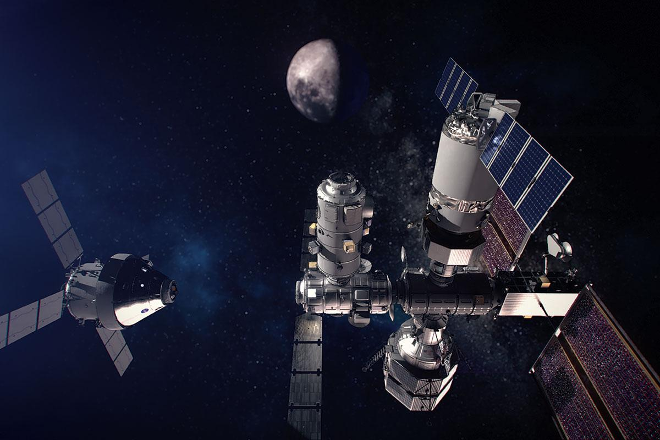
Introduction - Conceptual Problem
Moon
Crewed Station
Derived from NASA research inquiry
Crewed cislunar space station
A complex systems design problem
Visiting Vehicle
Shawn
Notes:
At bottom the problem that we’re really trying to solve is how to organize extremely large systems engineering projects such as Gateway. Model-based systems engineering provides one possible solution which we are exploring in our project.

Slide 4


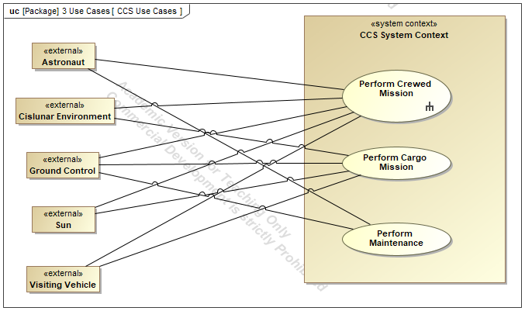

Introduction - Conceptual Problem
NASA is implementing Model-Based Systems Engineering (MBSE) into the design of Gateway
NASA is interested in identifying failures in the design
Improve the safety and reliability of the system design
Design Information
System Inquiry
Space Station
System Model
Conflicts
Analysis Report
Design Engineer
Stakeholder
Shawn
Notes:
Really the end goal of our project is to explore, develop, and document a way in which we can improve the safety and reliability of the Gateway system. They want to do this using model-based systems engineering. The system that we are modeling is a conceptual design of a system. We are studying the method, NASA is actually doing it.

Slide 5
Introduction - Technical Problem
Perform modeling research aligned with NASA’s needs
Model a conceptual Gateway-type system
A conceptual system called the Crewed Cislunar Station (CCS)
Perform Failure Modes and Effect Analysis (FMEA) on the model
Drives the creation of new safety requirements
Also drives new reliability requirements and system design
Luke

Slide 6
Introduction - Why Model-Based Systems Engineering?
“Document-based systems engineering sucks!” - Expert
Subsystem
Requirements Document
Stakeholder Needs Document
System
Model
Subsystem Structural Design Document
Subsystem Behavioral Design Document
Requirements Traceability Document
Luke

Slide 7
Introduction - System Overview
Crewed Station
Define the Crewed Cislunar Station (CCS) using SysML
Perform detailed modeling on CCS avionics system
Perform FMEA using the system model
Luke
Notes:
We’ve defined the system in SysML and built a system model. We’ve produced a model of this conceptual system in order to support FMEA.

Slide 8
Design Considerations

Slide 9



Design Considerations
Using SysML Language following INCOSE/OMG Standards
Following MagicGrid™ Framework
Local Modeling
No cloud server for collaboration
Clay
Notes:
INCOSE (International Council on Systems Engineering) standards, Object Management Group SysML, Dassault Systemes Magic System of Systems Architect, MagicGrid Framework The fact that it is a local model is a constraint

Slide 10
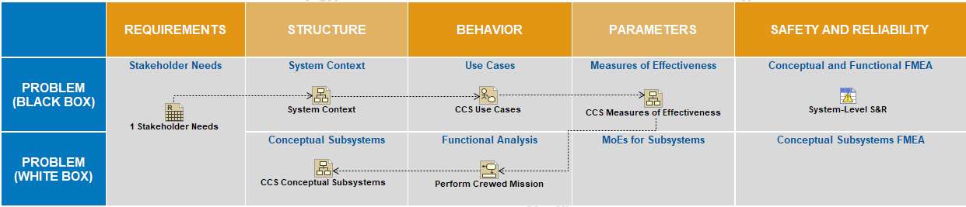
Design Considerations - MagicGrid™
Software: Magic Systems of Systems Architect 2022x, Dassault Systemes
Clay
Notes:
We’ve defined the system in SysML and built a system model. We’ve produced a model of this conceptual system in order to support FMEA.

Slide 11

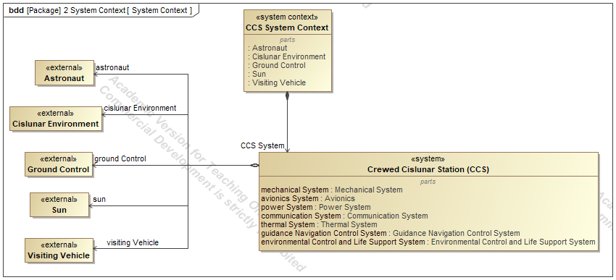
System Development Infrastructure
Use Case Model
Context Model
Clay
Notes:
Software, method, framework Explain about how we used GitHub and merging of projects to explain our workflow

Slide 12
Ancestor Merging
One person (Luke) is in charge of merging
Use Case Model
“Source”
“Merge”
“Ancestor”
main
“Target”
Clay
Notes:
Software, method, framework Explain about how we used GitHub and merging of projects to explain our workflow

Slide 13
System Architecture

Slide 14
System Architecture - Scope of Conceptual Model
Conceptual
Logical
Physical
Flight Computer
Antenna
Rocket Engine
…
2 flight computers
3 antennas
2 rocket engines
…
2 Raspberry Pi 4 Model B’s
1 High-Gain X-Band Antenna
2 S-Band Antennas
2 RS-25 Engines
…
Level of Abstraction
Shawn
Notes:
Our system architecture should be the system context diagram and the subsystem diagrams. Clip parts of the MagicGrid index to show the flow from one part to another

Slide 15
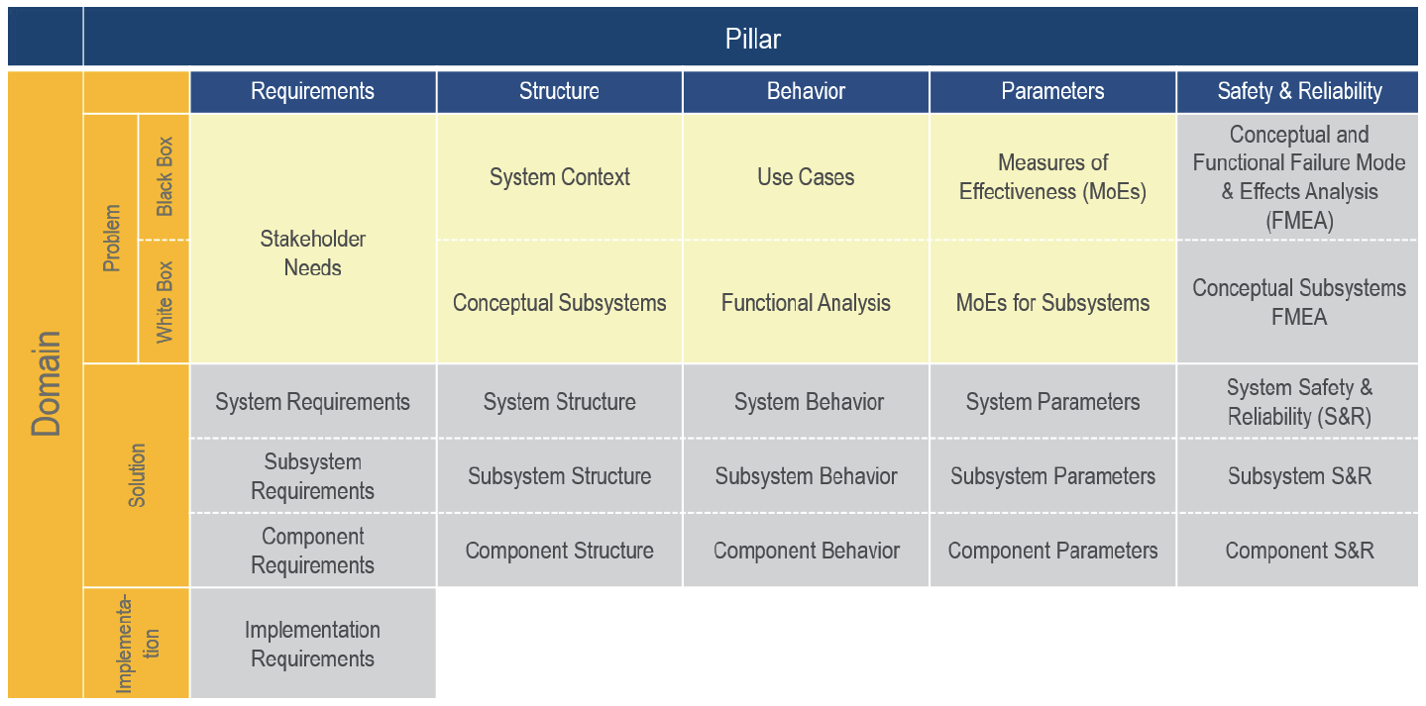
System Architecture - Scope of Conceptual Model
Shawn
Notes:
Our system architecture should be the system context diagram and the subsystem diagrams. Clip parts of the MagicGrid index to show the flow from one part to another

Slide 16
System Architecture - Scope of Conceptual Model
Black Box:
Stakeholder Needs
System Context
Use Cases
Measures of Effectiveness
White Box:
Functional Analysis
Conceptual Subsystems
Subsystem Measures of Effectiveness
Conceptual FMEA
Shawn
Notes:
Our system architecture should be the system context diagram and the subsystem diagrams. Clip parts of the MagicGrid index to show the flow from one part to another

Slide 17
Subsystem Design
Notes:
clay

Slide 18
Problem Domain
(Black Box)
Notes:
clay

Slide 19
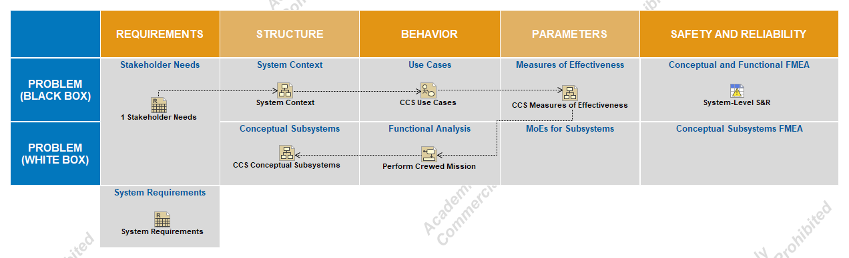
Sub-system - Stakeholder Needs
Clay
Notes:
Go into detail about black box/white box and explain our various diagrams.

Slide 20
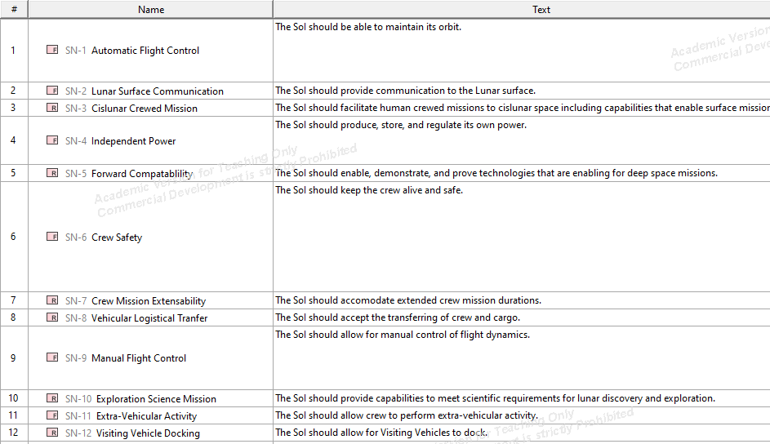
Sub-system - Stakeholder Needs
Clay
Notes:
Go into detail about black box/white box and explain our various diagrams.

Slide 21
Sub-system - System Context
Clay
Notes:
Go into detail about black box/white box and explain our various diagrams.

Slide 22
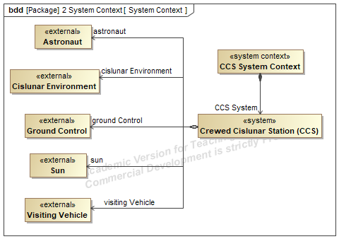
Sub-system - System Context Diagram
Clay
Notes:
Go into detail about black box/white box and explain our various diagrams.

Slide 23
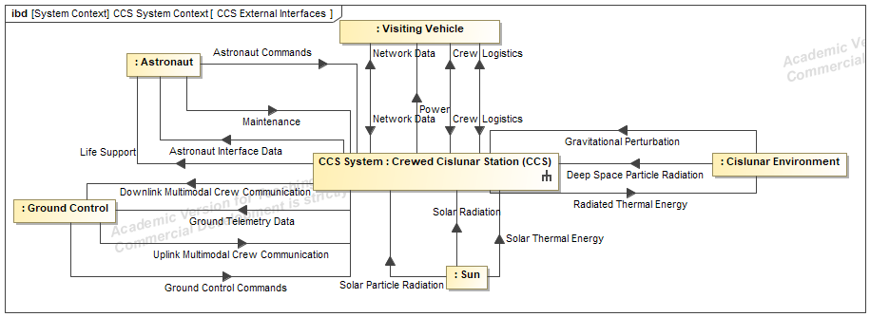
Sub-system - Context Diagram
Clay
Notes:
Go into detail about black box/white box and explain our various diagrams.

Slide 24
Sub-system - Use Cases
Clay
Notes:
Go into detail about black box/white box and explain our various diagrams.

Slide 25
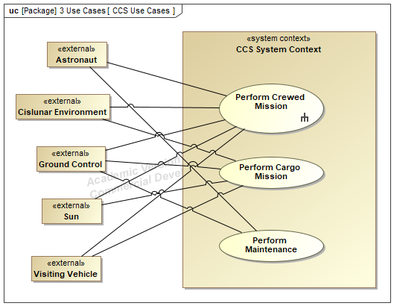
Sub-system - Use Case Diagram
Clay
Notes:
Go into detail about black box/white box and explain our various diagrams.

Slide 26
Sub-system - Measures of Effectiveness
Luke
Notes:
Go into detail about black box/white box and explain our various diagrams.

Slide 27
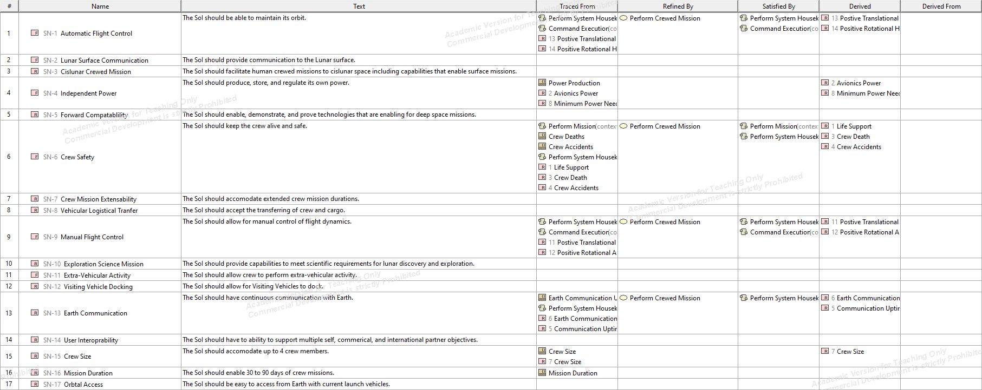
Sub-system - MoEs
Luke
Notes:
Measures of effectiveness are how we actually measure success of the system.

Slide 28
Sub-system - MoEs
Nonfunctional Requirement
Luke
Notes:
Measures of effectiveness are how we actually measure success of the system.

Slide 29
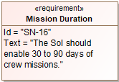
Sub-system - MoEs
Nonfunctional Requirement
Represented in the tool as a <<Requirement>> item
Luke
Notes:
Measures of effectiveness are how we actually measure success of the system.

Slide 30
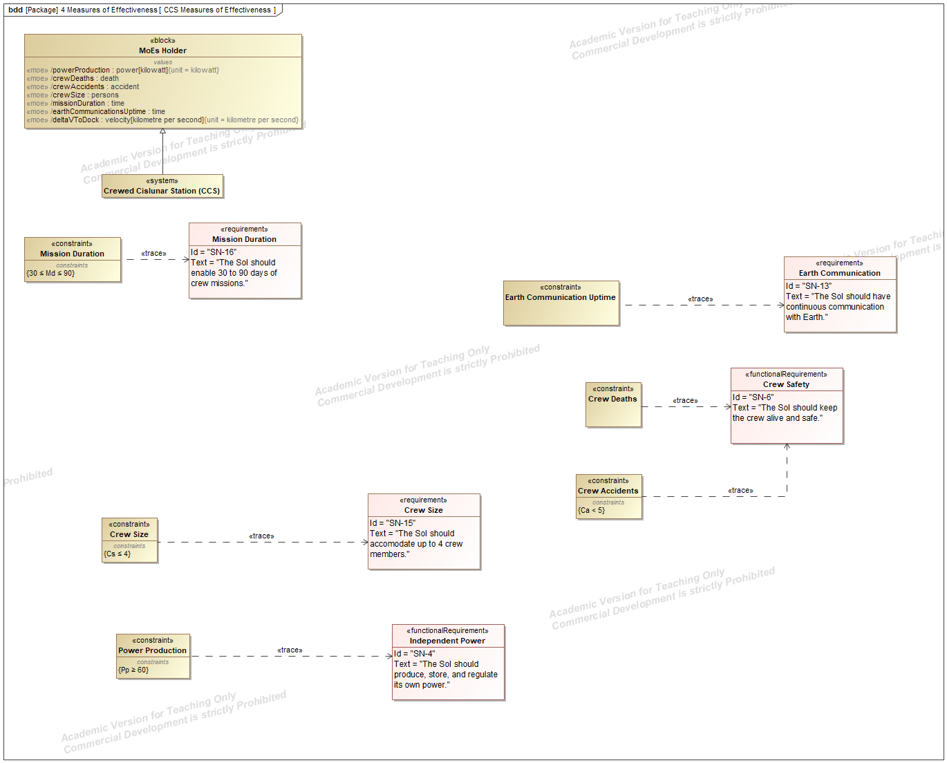
Sub-system - MoEs
Nonfunctional Requirement
Luke
Notes:
Measures of effectiveness are how we actually measure success of the system.

Slide 31
Sub-system - MoEs
Drives the identification of a
Measure of Effectiveness for the system
The relationship between the constraint and the MoE defines success criteria
Luke
Notes:
Measures of effectiveness are how we actually measure success of the system.

Slide 32
Problem Domain
(White Box)
Notes:
clay

Slide 33
Sub-system - Functional Analysis
Luke
Notes:
Go into detail about black box/white box and explain our various diagrams.

Slide 34
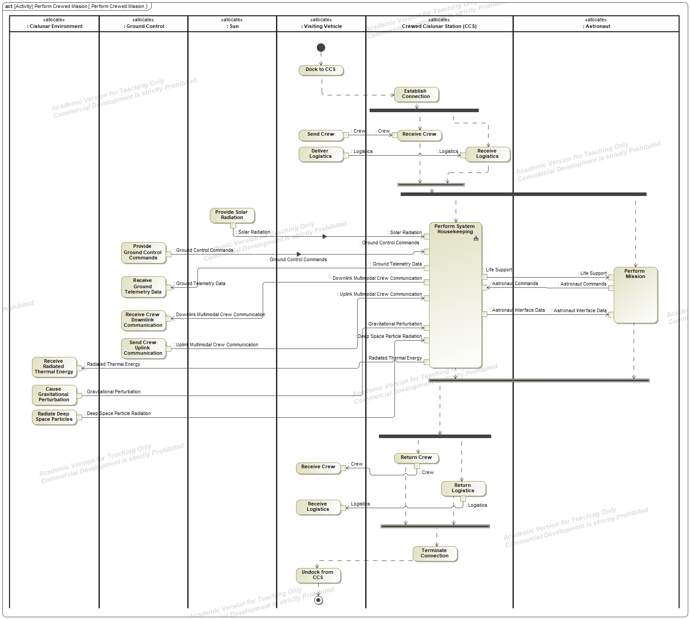
Luke
Notes:
Functional analysis captures/generates the functional requirements of the system

Slide 35
Notes:
Go into detail about black box/white box and explain our various diagrams.

Slide 36
Notes:
Go into detail about black box/white box and explain our various diagrams.

Slide 37
Sub-system - Conceptual Subsystems
Shawn
Notes:
Go into detail about black box/white box and explain our various diagrams.

Slide 38
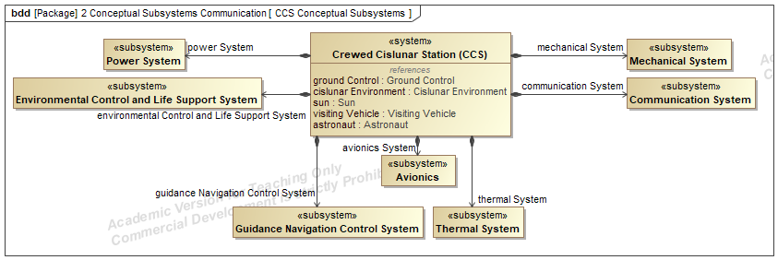
Sub-system - Conceptual Subsystems
Shawn
Notes:
Go into detail about black box/white box and explain our various diagrams.

Slide 39
Sub-system - Conceptual Subsystems
Shawn
Notes:
Go into detail about black box/white box and explain our various diagrams.

Slide 40
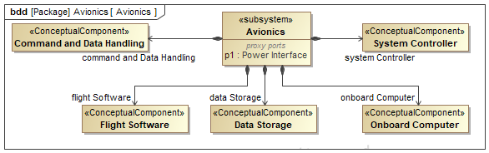
Sub-system - Conceptual Components
Shawn
Notes:
Go into detail about black box/white box and explain our various diagrams.

Slide 41
Project Live Demo

Slide 42
Sub-system - Conceptual FMEA (Live Demonstration)
Walter
Notes:
Go into detail about black box/white box and explain our various diagrams.

Slide 43
Sub-system - Conceptual FMEA
1. Identify Failure
Antenna Power Failure
2. Trace Failure
System Requirements
Power Subsystem
4. Improve Design
Redundant power
3. Generate Requirements
Walter
Notes:
Go into detail about black box/white box and explain our various diagrams.

Slide 44
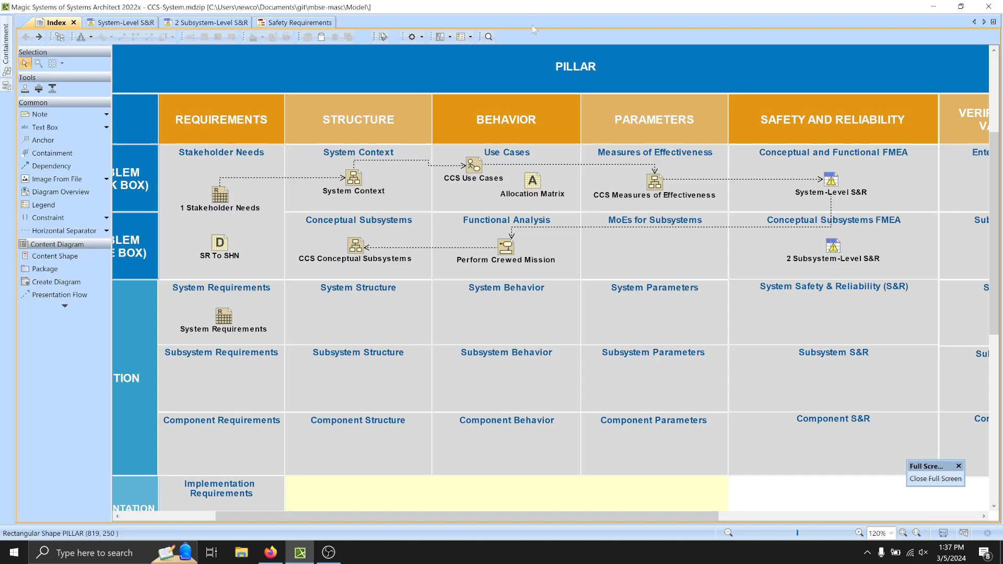
Notes:
Go into detail about black box/white box and explain our various diagrams.

Slide 45
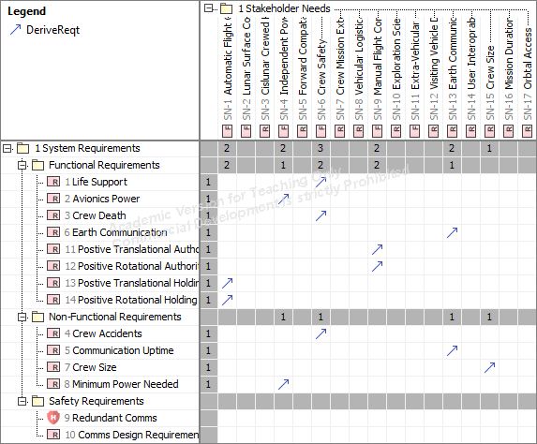
Traceability Example
Luke

Slide 46
Project Process

Slide 47
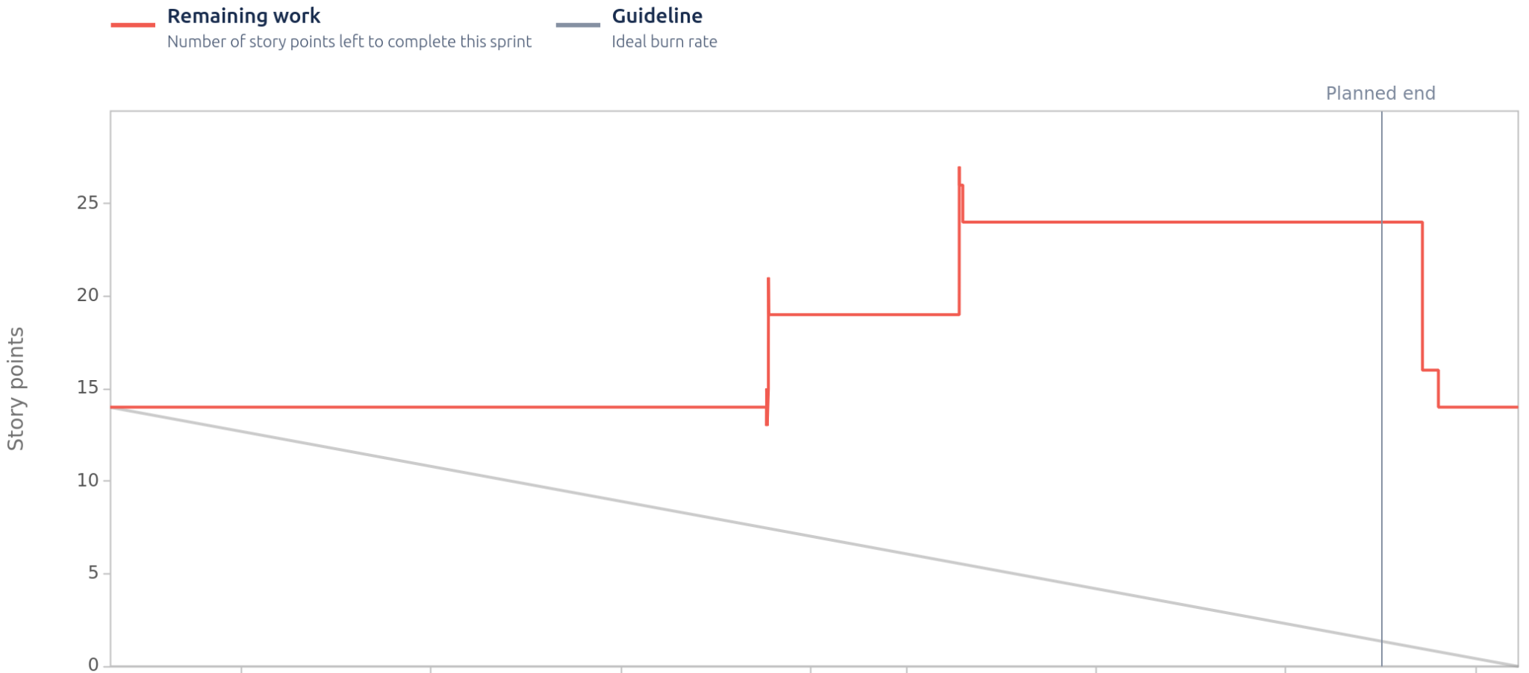
Project Timeline
Walter

Slide 48
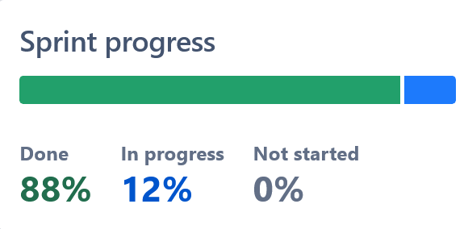
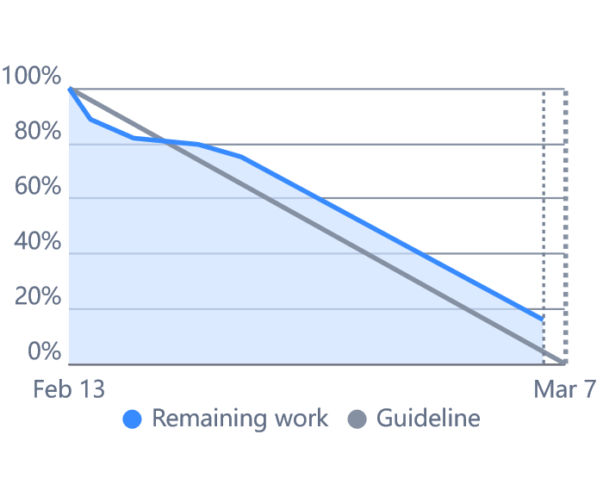
Project Timeline
(We got much better!)
Walter

Slide 49

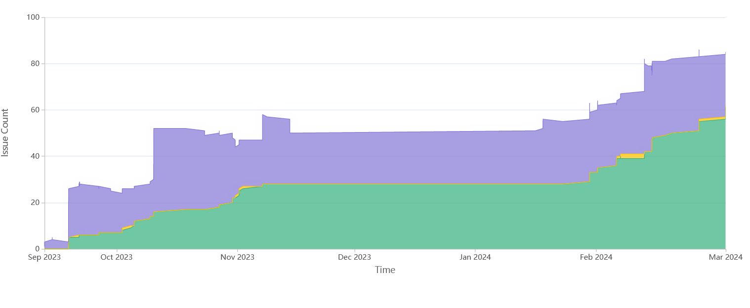
Project Timeline
Walter

Slide 50
Project Timeline and Semester Milestones
Conceptual System Model
Baseline
Conceptual FMEA
Baseline
Final Model Evaluation
Final Demo
Project Start
Project Final
Semester 1
Semester 2
Sprint 1 and 2
Semester 2
Sprint 3
We are here
Walter

Slide 51
Budget
Commercial License Cost
For our project:
$97 per academic license
$400 in total
If we were a company:
$900 per commercial license
At least $3,600 for the 4 of us
Academic License Cost
Shawn

Slide 52
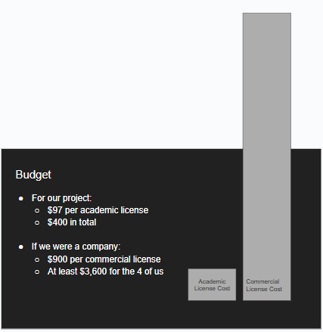
Budget
Shawn

Slide 53
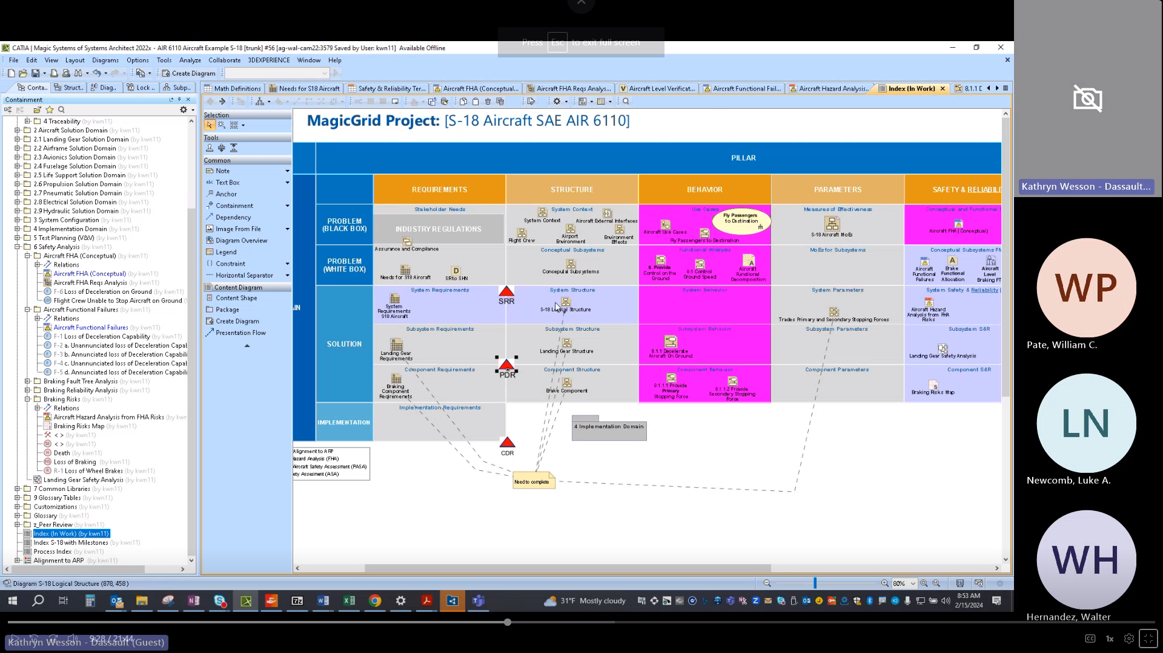
Lessons Learned
Using the Agile process:
Revisit each model multiple times
Have consistent feedback
Constantly generating new requirements
Setting up recurring weekly meetings helped us greatly:
Task Delegation
Time Management
Recording Meetings
Teams Meeting Recording
Shawn

Slide 54
Questions?

